Slide 1
CS 4530: Fundamentals of Software Engineering
Module 3.1: Trusting TypeScript (or not!)
Adeel Bhutta, Rob Simmons, and Mitch Wand
Khoury College of Computer Sciences
© 2026 Released under the CC BY-SA license

Slide 2
Learning Goals for this Lesson
At the end of this lesson, you should be able to
  Explain how TypeScript types and documented preconditions influence what tests you need to write
  Explain the difference between the any vs unknown types in TypeScript

Slide 3
What Inputs Should We Test?
What input values do I need to test this function on?
/**
* Prints "hello" repeatedly
*
* @param numHellos - number of times to print “hello”,
* must be an integer >= 0
*/
function helloNTimes(numHellos: number) {
for (let i = numHellos; i !== 0; i--) {
console.log('hello');
}
}
Notes:
Recall Assemble/Act/Assess. Testing a function like this one is always going to involve:
- Assembling an input
- Acting by passing that input to the function
- Assessing something about what the function does
How should we test this function? What inputs should we pass it?

Slide 4
What Inputs Should We Test?
What input values do I need to test this function on?
Edge cases (definitely 0)
Probably 1 and some larger number?
But most numbers > 1 are kind of interchangeable.
  If we want to sound fancy, we can call these “equivalence classes of inputs.”
What about -3? 1.4? NaN? null? { lol: 'owned' } ?
/**
* Prints "hello" repeatedly
*
* @param numHellos - number of times to print “hello”,
* must be an integer >= 0
*/
function helloNTimes(numHellos: number)
Notes:
There are two types of contracts in this function: the TypeScript one says that the input must be a number, and the one document in the precondition that says that it must be a nonnegative integer.

Slide 5
For Unit Testing, Tests Inputs Should Respect a Function’s Contracts
Unit Tests: testing a single function in isolation
  Unit testing only needs to give a function tests that respect the functions preconditions: no need to test -3 or 1.4
Integration Tests test how different parts of a program work together, and that’s where we’re concerned with ensuring that other parts of the program respect our function’s contracts.
/**
* Prints "hello" repeatedly
*
* @param numHellos - number of times to print “hello”,
* must be an integer >= 0
*/
function helloNTimes(numHellos: number)
Notes:
This is something we’ll return to later, but the answer to “which inputs should we test” is that we don’t need to test this function with -3 or null.
When we’re talking about testing a specific function, we’re really talking about writing a unit test, that tests an isolated part of a program. Other parts of the program are responsible for respecting the contracts on our function, but that’s a problem for integration testing, which we’ll talk about more in a future lecture.

Slide 6
For Unit Testing, Tests Inputs Should Respect a Function’s Contracts
Unit Tests: testing a single function in isolation
  Unit testing only needs to give a function tests that respect the functions preconditions: no need to test -3 or 1.4
Integration Tests test how different parts of a program work together, and that’s where we’re concerned with ensuring that other parts of the program respect our function’s contracts.
/**
* Prints "hello" repeatedly
*
* @param numHellos - number of times to print “hello”,
* must be an integer >= 0
*/
function helloNTimes(numHellos: number)
Notes:
This is something we’ll return to later, but the answer to “which inputs should we test” is that we don’t need to test this function with -3 or null.
When we’re talking about testing a specific function, we’re really talking about writing a unit test, that tests an isolated part of a program. Other parts of the program are responsible for respecting the contracts on our function, but that’s a problem for integration testing, which we’ll talk about more in a future lecture.

Slide 7
TypeScript Types Are Easily Circumvented (1)
In a language like Java, we’d need to worry that another function could call helloNTimes with -3, but not with a string or null.
That’s not true in TypeScript!
/**
* Prints "hello" repeatedly
*
* @param numHellos - number of times to print “hello”,
* must be an integer >= 0
*/
function helloNTimes(numHellos: number)
Notes:
This brings us to a critical point about TypeScript, and one that can be really surprising at first.
In Java, we’d need to be concerned that some malicious function would call an analogue of “helloNTimes” with a negative number, but there’d be no way to call it with a value of some completely unexpected type: Java would never allow such a thing to happen.

Slide 8
TypeScript Types Are Easily Circumvented (2)
In a language like Java, we’d need to worry that another function could call helloNTimes with -3, but not with a string.
That’s not true in TypeScript!
TypeScript types are, at the end of the day,
no better than preconditions mentioned in comments.
  helloNTimes({ lol: 'owned ' } as unknown as number)
They do seem to make it less likely you’ll screw up accidentally…
Notes:
Unlike some languages, the type contracts in TypeScript are totally unchecked — Node will happily run the function with an argument that is not a JavaScript number at all, just as it will happily run it on an input that violates the “nonnegative integer” contract in the precondition. This is fundamental to TypeScript but can be very confusing if you’re used to types in languages that aren’t Python and JavaScript.
So why are we using TypeScript at all? Well, a lot of people obviously find a lot of value in using TypeScript, and we’re using it in this course for a reason. The reality is that different software projects use TypeScript in fundamentally different ways. It’s possible, in most cases, to make choices in a project that make mistakes less likely. In general, the more you TypeScript type to prevent violating a function’s contracts, the faster you’ll find bugs, and the less you’ll need to rely on your integration tests to find issues.
Our project code sets up the ESLint linter with a lot of rules that enforce this strict use of TypeScript.

Slide 9
What Trusting Contracts Looks Like
/**
* Adds a message to a chat, updating the chat
*
* @param chatId - Ostensible chat id
* @param user - Authenticated user
* @param messageId - Valid message id
* @returns the updated chat info object
* @throws if the chat id is not valid
*/
export function addMessageToChat(
chatId: string,
user: UserWithId,
messageId: string
): ChatInfo {
Notes:
Here’s a more real version of the initial example, a piece of code from the project codebase. Both the comments and the types are telling us about the function’s preconditions, which help set the expectations for testing the code.
We’d definitely want to test this function with a valid chat ID and an invalid chat ID.
TypeScript won’t consistently enforce that we’ll only pass a message ID that’s a string, and not a number or an object or something else — and TypeScript definitely won’t enforce that you only call the function with valid message IDs that correspond to actual messages. But the contracts on this function — but if we’re trusting that this function will be called in ways that respect the function’s contracts, we don’t need to test it with a message ID 4, or with a random string message ID that doesn’t correspond to a message.
But maybe we don’t trust ourselves and the evolution of our code over time, so we want to write the test anyway! There’s not a single right answer. What are the tradeoffs for writing tests that violate the stated preconditions? (One answer: if you write tests that violate the preconditions, that may push you to check for the precondition violation in code. Which means your code is now more slower and more complicated than it had to be!)

Slide 10
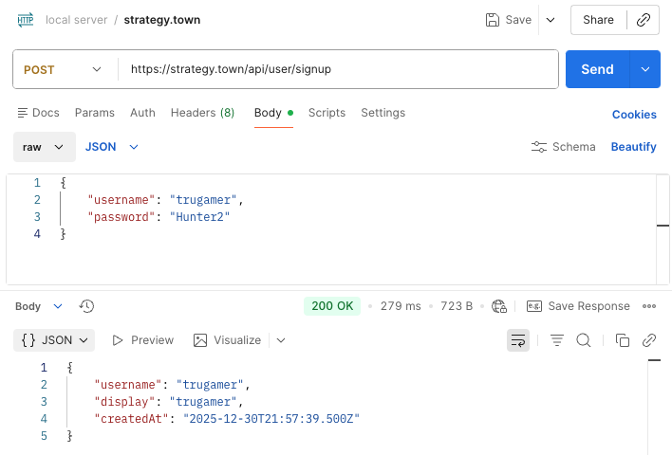
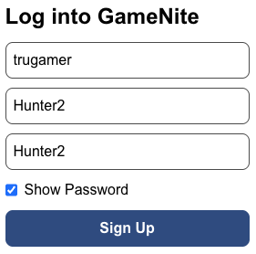
Untrusted Inputs
Any input given to a web app
can also be given by other
means…
curl https://strategy.town/api/user/signup -H 'Content-Type: application/json' \
--data '{ "username": "trugamer", "password": "Hunter2" }'
Notes:
Not all inputs to your programs can be trusted to have any particular shape or form!
When you give an input to a website through a web browser, the code on the web browser will make sure the request has a specific format. But the nature of web applications is that those submissions can always be done in different ways, without the same guardrails.
On the upper right we show the same action of creating a GameNite account being done through the “Postman” program (there’s a Postman tutorial on the website), and on the command line with a command-line “curl” command. (You can get “curl” commands out of Postman too.)

Slide 11
Untrusted Inputs should be unknown
The appropriate TypeScript type for an unknown value is unknown
function lookAtMe(input: unknown) {
console.log(input.toUpperCase());
if (typeof input === "string") {
console.log(input.toUpperCase());
}
}
If you use the any type instead, TypeScript will just say “ok, I guess you know what you’re doing”
TypeScript error here!
it’s ok here!
Notes:
TypeScript has a way of dealing with inputs when you can’t trust that the input is going to obey any sort of contract: the unknown type.
(click)
If you have an unknown value and you try to do pretty much anything to it (such as cast it to uppercase like it’s a string), TypeScript will yell at you.
(click)
But if you check that it’s a string first with JavaScript’s typeof function, TypeScript will then remember that you’ve checked that it’s a string.

Slide 12
Untrusted Inputs Should be “unknown”
This can get complicated fast…
type Auth = { username: string, password: string }
function useAuth(x: unknown) {
if (
(typeof x === 'object' && x !== null) &&
('username' in x && typeof x.username === 'string’) &&
('password' in x && typeof x.password === 'string’)
) {
const auth: Auth = { username: x.username, password: x.password };
// write the code you care about here!
}
}
Notes:
This was just about shortest code I could come up with to use straightforward TypeScript to reliably take an unknown piece of data and get record with a string username and a string password. It’s not simple!
TypeScript makes us do all the work ourselves if we want to check that a value actually matches the structure that its type suggests. This is difficult and error-prone in practice.

Slide 13

Libraries Make Checking Types Easier
Zod is a library that makes testing the structure of inputs less tedious and error-prone.
import { z } from 'zod';
const zAuth = z.object({ username: z.string(), password: z.string() });
type Auth = z.infer<typeof zAuth>;
// { success: false }
console.log(zAuth.safeParse({ username: 4, password: null }))
// { success: true, data: { username: "", password: "" } }
console.log(zAuth.safeParse({ username: "", password: "" }))
Notes:
Zod is a library that makes our job easier — we can create Zod representations of the TypeScript types, and then use a function like safeParse to ensure that the object really has the structure we expect it to have.
(click)
If you put this code in VSCode and hover over “Auth”, you’ll see it’s exactly the type that we want, so we don’t even have to write the same type twice.

Slide 14
Using “any”: Common, Not Great
import express from 'express';
const app = express();
app.use(express.json());
type Auth = { username: string; password: string };
app.post('/', (req, res) => {
const auth: Auth = req.body;
if (auth.password !== 'secret') {
res.status(403).send({ error: 'Wrong password' });
} else {
res.send({ message: `WELCOME,${auth.username.toUpperCase()}` });
}
});
app.listen(8000, () => console.log(`Listening on port 8000`));
Only accept JSON
This has type “any” 😭
Notes:
Here’s a small webserver that uses Express, the same library that the course project uses.
(click)
The third line (where the first arrow is pointing) covers an enormous amount of validation — it ensures that our web server will only respond to specific requests that send JSON data (we’ll be using JSON data a lot in the class, there’s an article about it in the resoures for this lecture)
(click)
However, the line that lets `req.body` be treated as an `Auth` (where the second arrow is pointing) has some really unfortunate typescript happening. If you read this line, it looks like you’re now able to trust that the request body matches the `Auth` type. But this is not true. This line only works in Typescript because the express library treats untrusted request bodies as “any”, not as “unknown.” This makes the express server a lot easier to use… and also makes it a lot easier to make errors.
Given how complicated we just saw it was to make sure that an unknown input had the correct format, this decision mostly makes sense.
(Optional Q: what input would cause an exception that typescript would seem to make impossible? See next hidden slide)

Slide 15
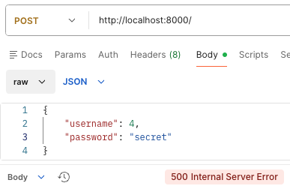
Using “any”: Common, Not Great
import express from 'express';
const app = express();
app.use(express.json());
type Auth = { username: string; password: string };
app.post('/', (req, res) => {
const auth: Auth = req.body;
if (auth.password !== 'secret') {
res.status(403).send({ error: 'Wrong password' });
} else {
res.send({ message: `WELCOME,${auth.username.toUpperCase()}` });
}
});
app.listen(8000, () => console.log(`Listening on port 8000`));
Notes:
Plausible but incorrect answer: null or 3, anything that will cause an error if you try to project out the “password” field. This actually doesn’t work, because express.json() only accepts JSON that represents an object or an array.
You can allow any JSON by replacing express.json() with express.json({ strict: false })
True answer: something like { username: 4, password: “secret” } will try to invoke the toUpperCase method of the numeric value 4, but JavaScript numbers don’t have toUpperCase methods — only strings do!

Slide 16
Improving This Web Server With Zod
import { z } from 'zod';
import express from 'express';
const app = express();
app.use(express.json());
const zAuth = z.object({ username: z.string(); password: z.string() });
app.post('/', (req, res) => {
const auth = zAuth.safeParse(req.body);
if (auth.error) {
res.status(400).send({ error: 'Unexpected message' });
} else if (auth.data.password !== 'secret') {
res.status(403).send({ error: 'Wrong password' });
} else {
res.send({ message: `WELCOME,${auth.data.username.toUpperCase()}` });
}
});
app.listen(8000, () => console.log(`Listening on port 8000`));
Notes:
Express’s design was set in stone before tools like Zod existed that made it easier to build code that actually gets validation right.

Slide 17
Review
One view of TypeScript is that it’s a handy way of documenting, and imperfectly checking, the contracts (preconditions and postconditions) of your code
Do you need to test inputs that violate your contracts? It depends!
You can never trust that the input to a web server will obey any sort of contract — important to test!
Notes:
There’s not a good answer to whether you need to test inputs that violate your contracts!
But you can’t trust anything that you’re receiving from the user over a network connection, even if the webpage prevents certain user actions. Many, many security vulnerabilities are just people getting this wrong.

